Slide 1
Chongqing University of Technology
ATAI
Advanced Technique of Artificial Intelligence
Chongqing University of Technology
Learning Heterogeneous Temporal Patterns of User Preference for Timely Recommendation （WWW2021）
报告人：彭展望

Slide 2
Outline
Introduction
Related Work
Method
Experiment
Conclusion

Slide 3
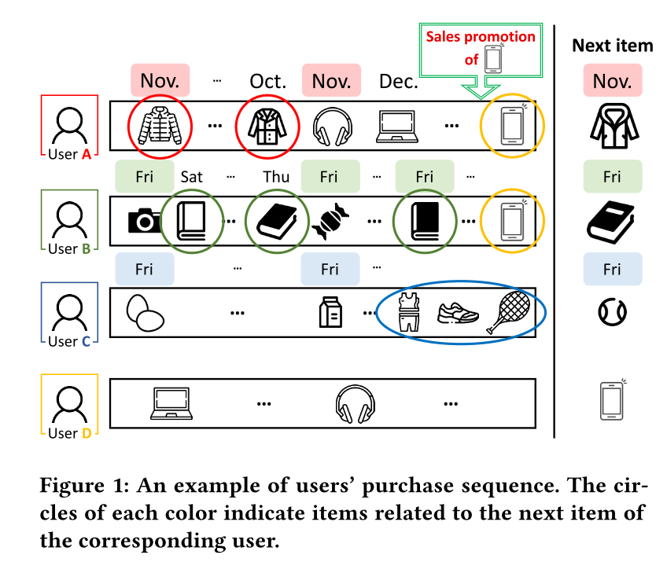
Introduction

Slide 4
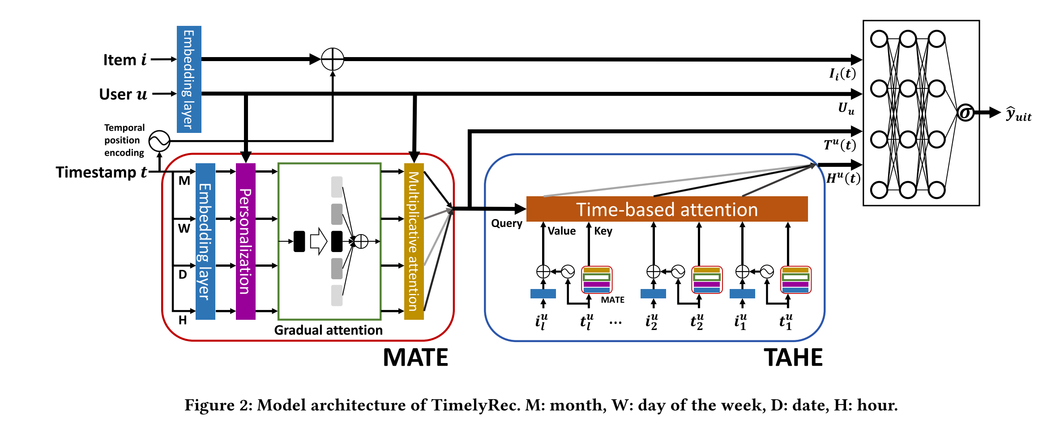
Method

Slide 5
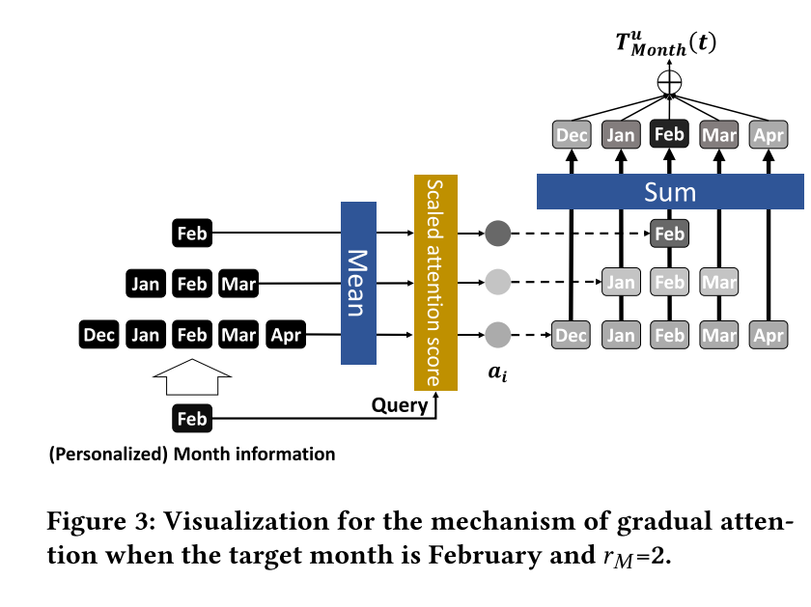
Method
Multi-aspect Time Encoder (MATE):
M:1-12月 W:周一到周天 D:1号到31号 H:1-24小时
Notes:
M:1-12月 W:周一到周天 D:1号到31号 H:1-24小时

Slide 6
Method
Multi-aspect Time Encoder (MATE):

Slide 7
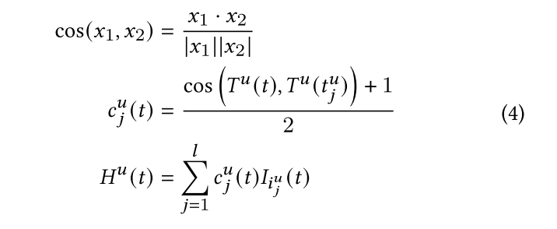
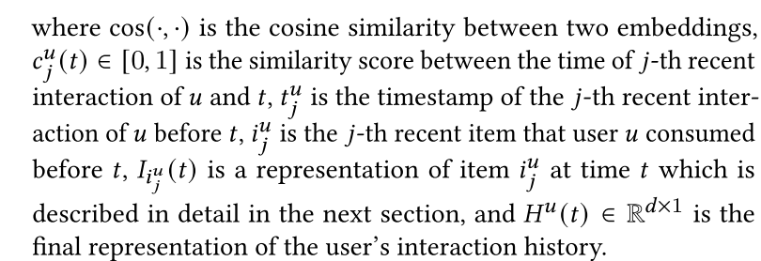
Method
Time-aware History Encoder (TAHE)

Slide 8
Method
Prediction:

Slide 9
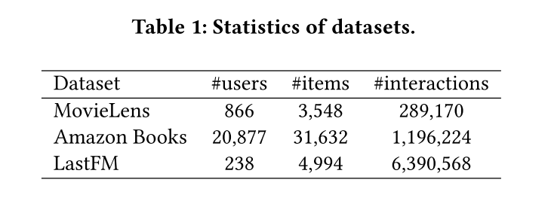
Dataset

Slide 10
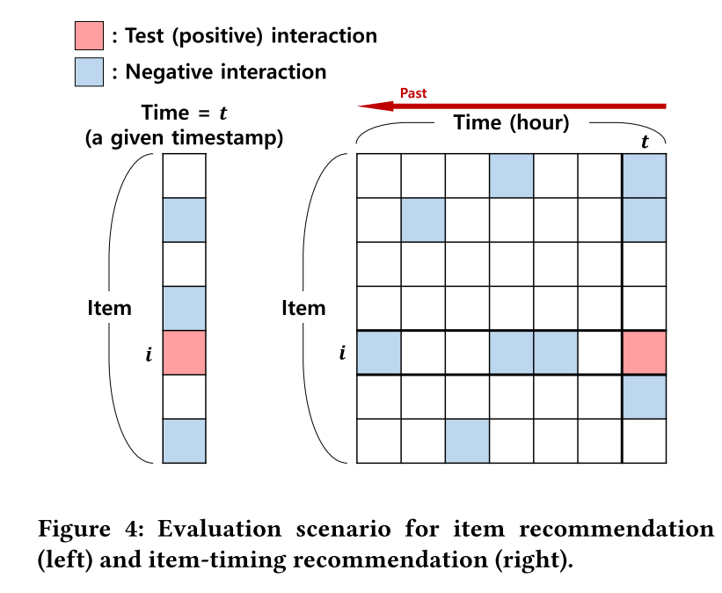
Experiment
Positive interaction:
Negative interaction:

Slide 11
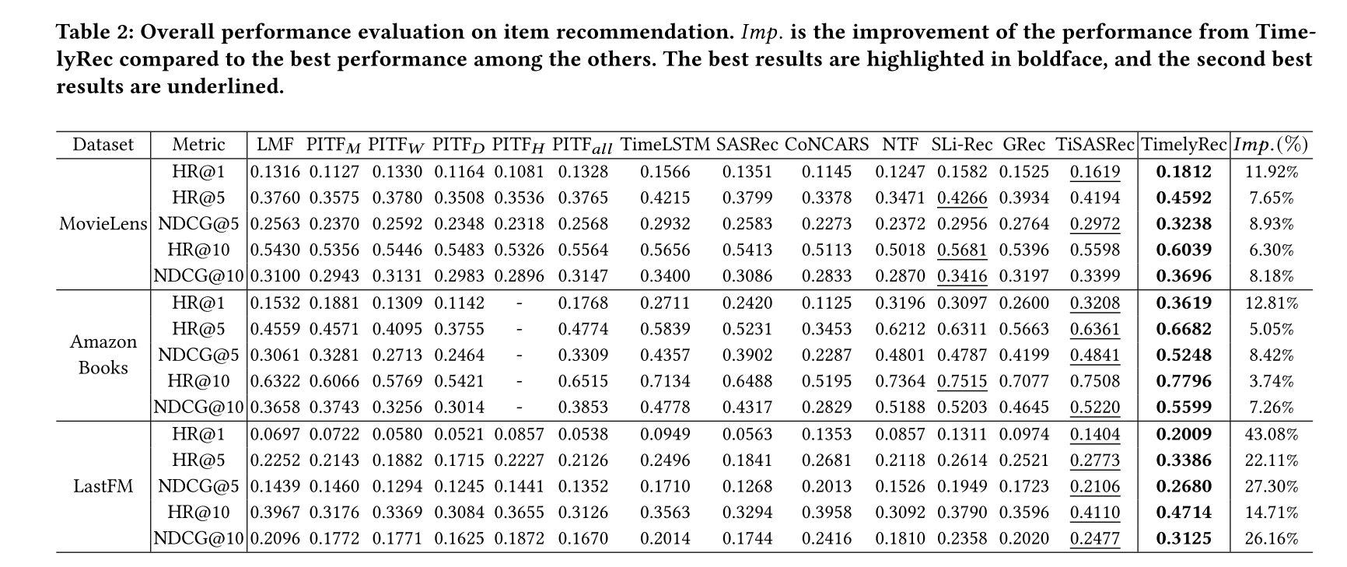
Experiment

Slide 12
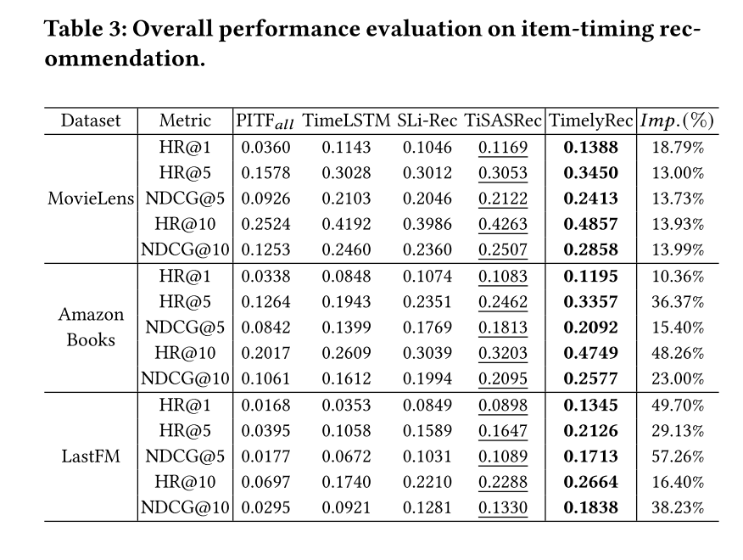
Experiment

Slide 13
Experiment

Slide 14
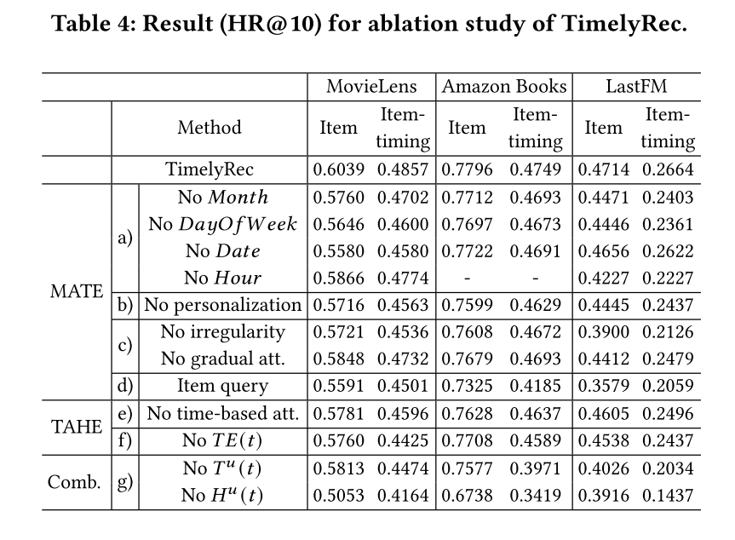
Experiment

Slide 15
Experiment

Slide 16
Experiment

Slide 17
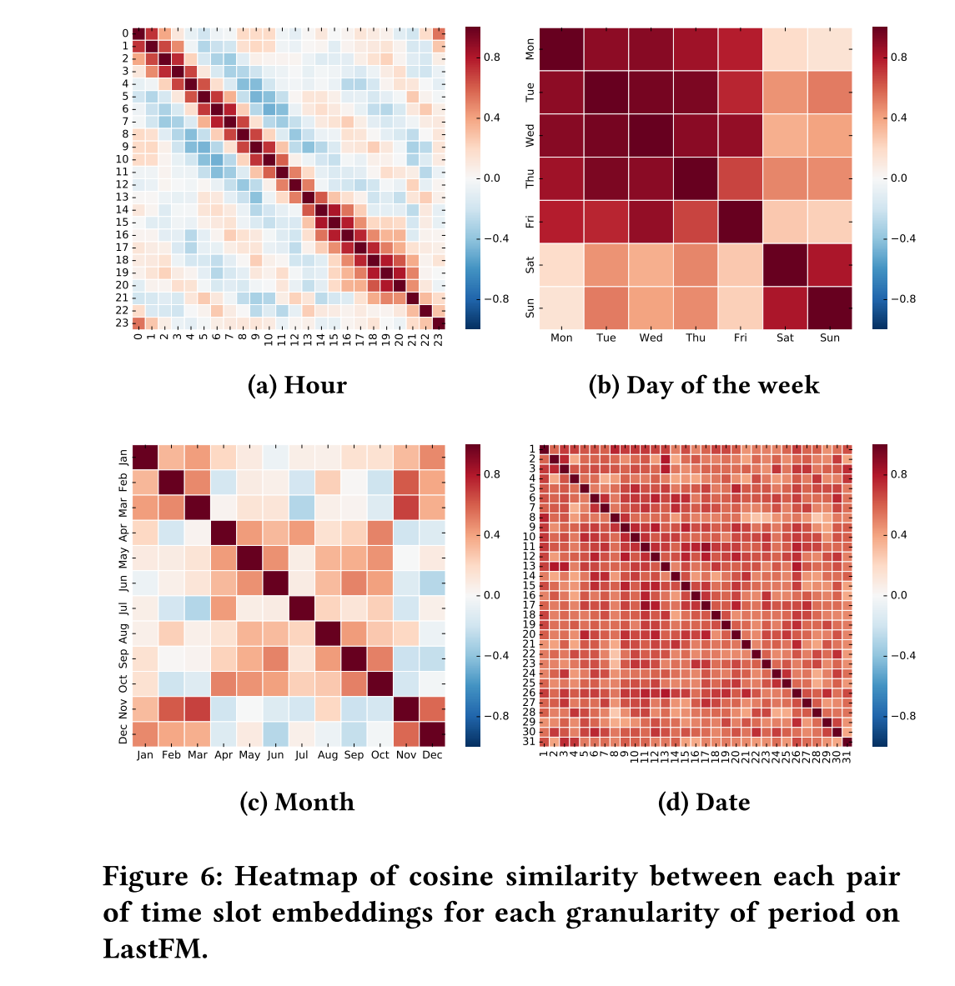
Experiment

